Slide 1
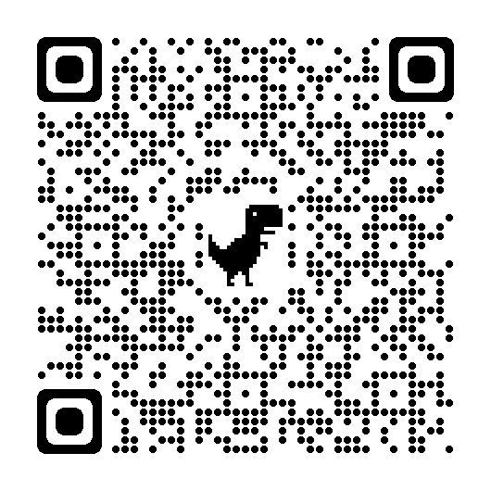
tinyurl.com/ssi-feedback
Please fill out this quick feedback form so that we can improve the conference, the journal, and the International Society on Solid State Ionics!

